Slide 1

ST.ANN’S COLLEGE OF ENGINEERING AND TECHNOLOGY
CHIRALA
DEPARTMENT OF ELECTRICAL AND ELECTRONICS ENGINEERING
IMPROVEMENT OF POWER QUALITY USING FACTS DEVICE
BATCH-8
PROJECT ASSOCIATES:
M.SINDHU(10F01A0274) P.JOHN DAVID RAJU(10F01A0294)
D.SRIKANTH(11F05A0206) Y.UTTAMA LAKSHMI(10F01A02B8)
Under the esteemed guidance of:
S.V.D. Anil Kumar
M.Tech, (Ph.D)
Head of the Department
Associate Professor

Slide 2

Introduction
This work aims at the improvement of power quality by
Voltage stabilization
Power factor correction
Transmission line loss reduction

Slide 3
Contents
Introduction of the project
Technology
Schematic diagrams
Matlab design of case study and results

Slide 4
Technology
Modulated Power Filter Compensator (MPFC) scheme for the smart grid stabilization and efficient utilization.
The MPFC is controlled by a novel tri-loop dynamic error driven inter coupled modified PID controller.
MATLAB Simulink

Slide 5
Problem Formulation
To Improve the dynamic behavior of different types of loads and improving the power quality.
The cases include:
Normal operating condition
Short circuit condition
Hybrid load excursion case
with MPFC and without MPFC.

Slide 6
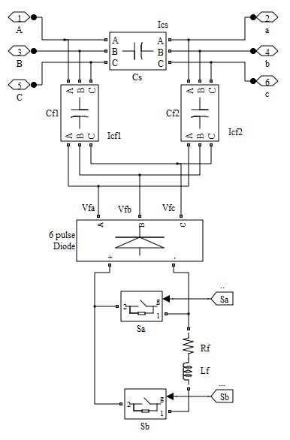
Modified Power Filter Compensator structure

Slide 7
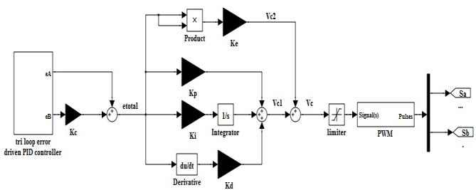
Modified tri loop error driven PID controller

Slide 8
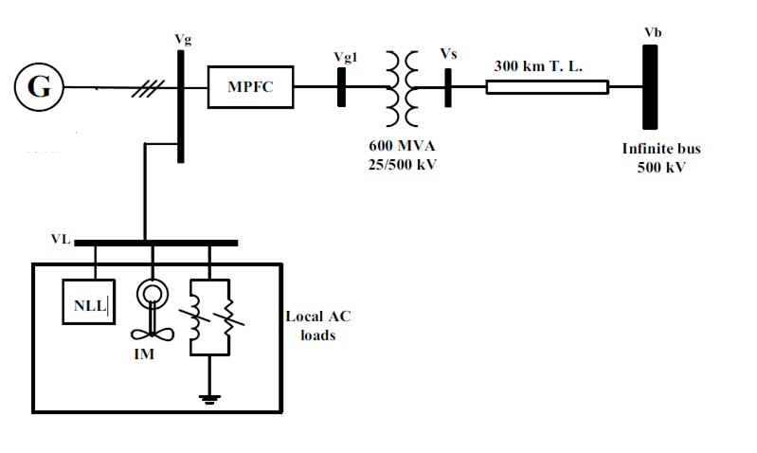
The Sample AC system

Slide 9
Loads model

Slide 10
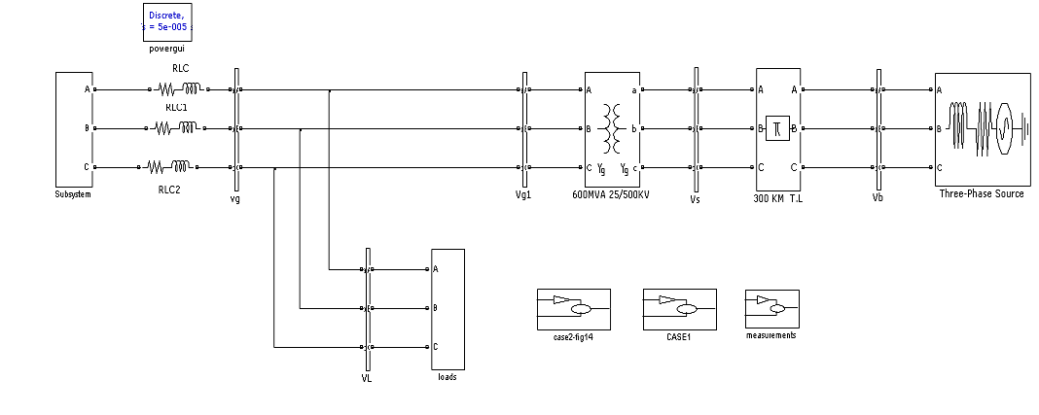
Design without MPFC

Slide 11
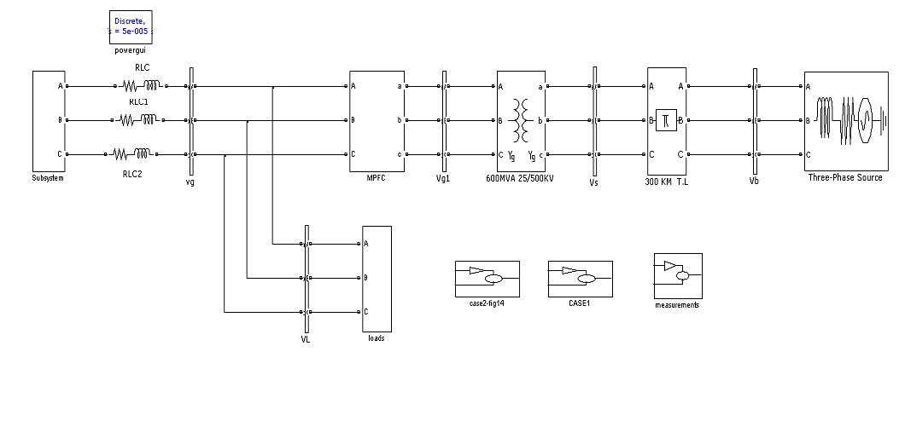
Design with MPFC

Slide 12
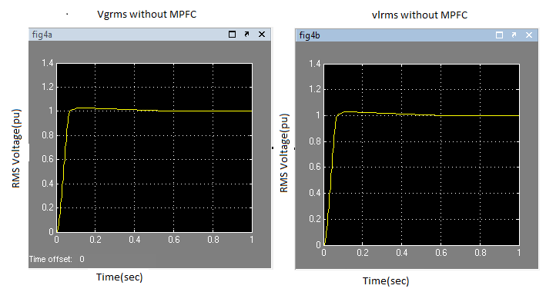
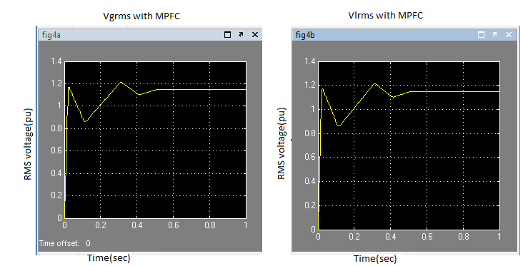
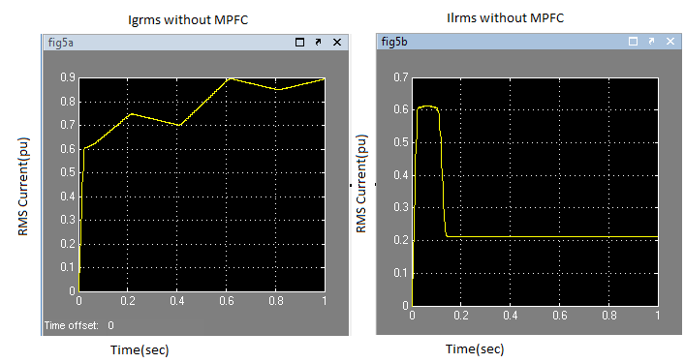
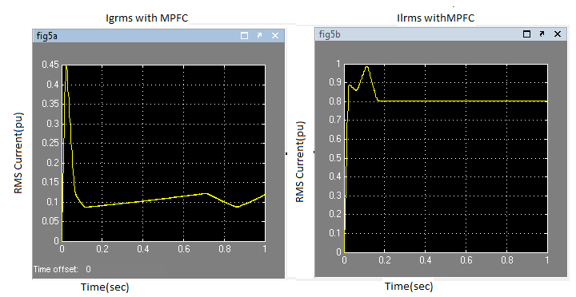
SIMULATION RESULTS

Slide 13
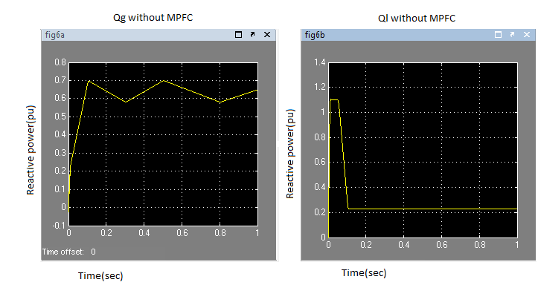
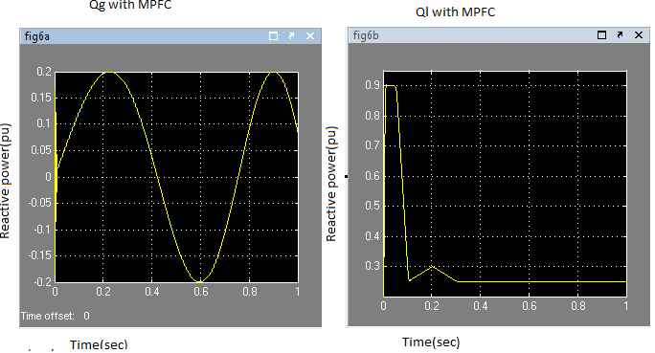
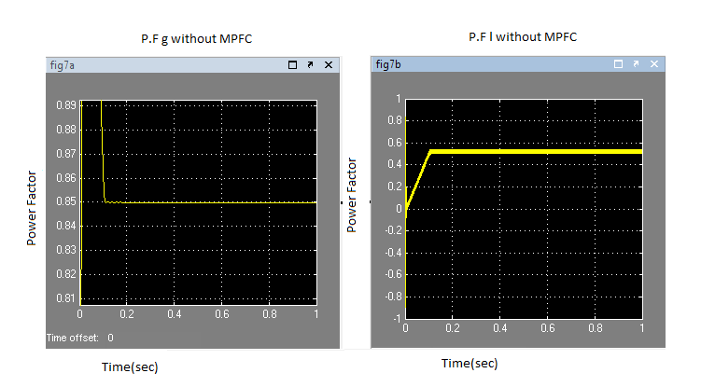
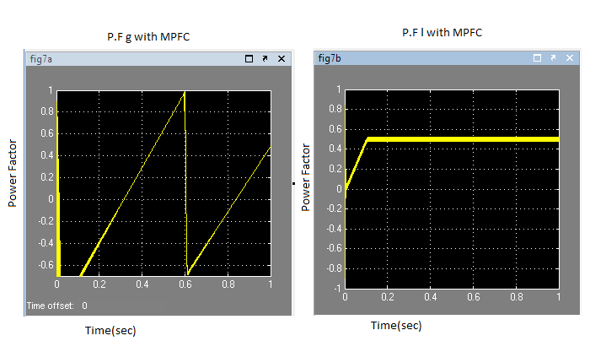
SIMULATION RESULTS

Slide 14
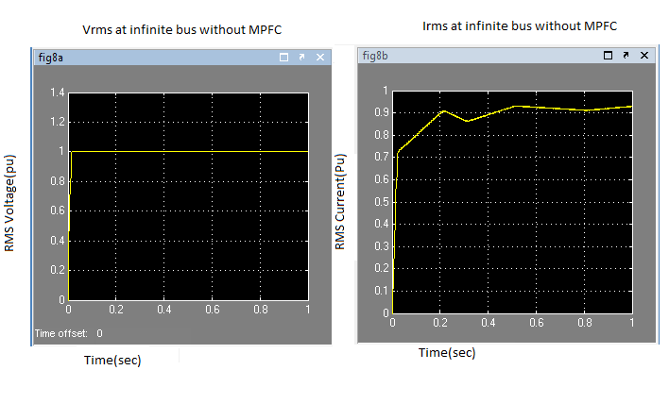
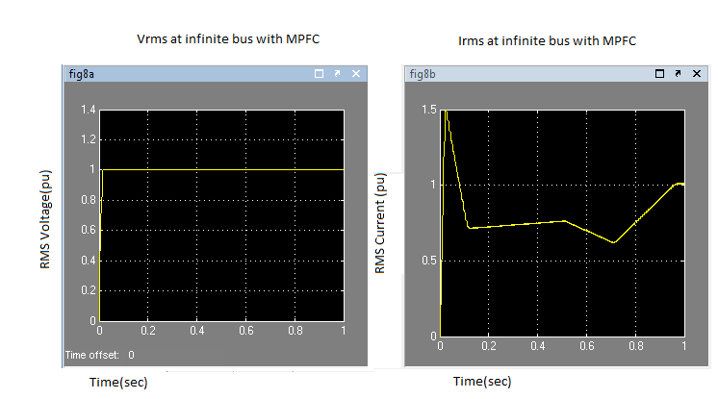
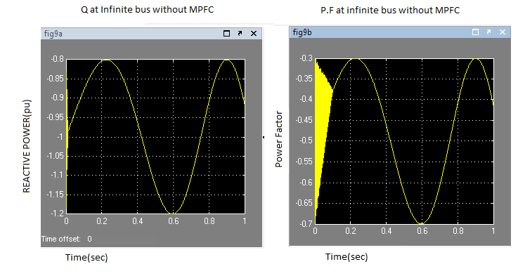
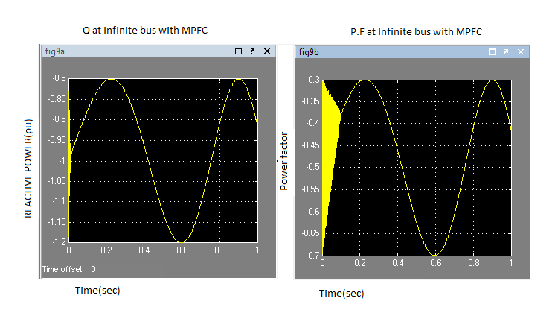
SIMULATION RESULTS

Slide 15
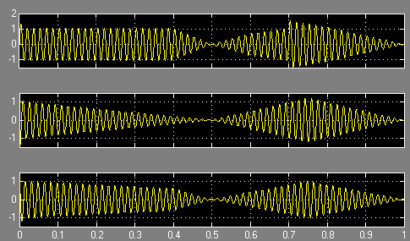
The voltage waveforms of MPFC

Slide 16
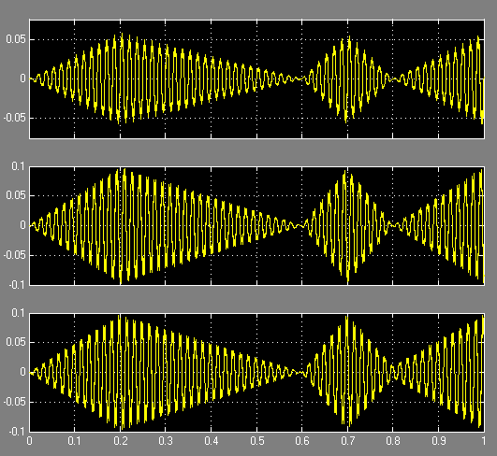
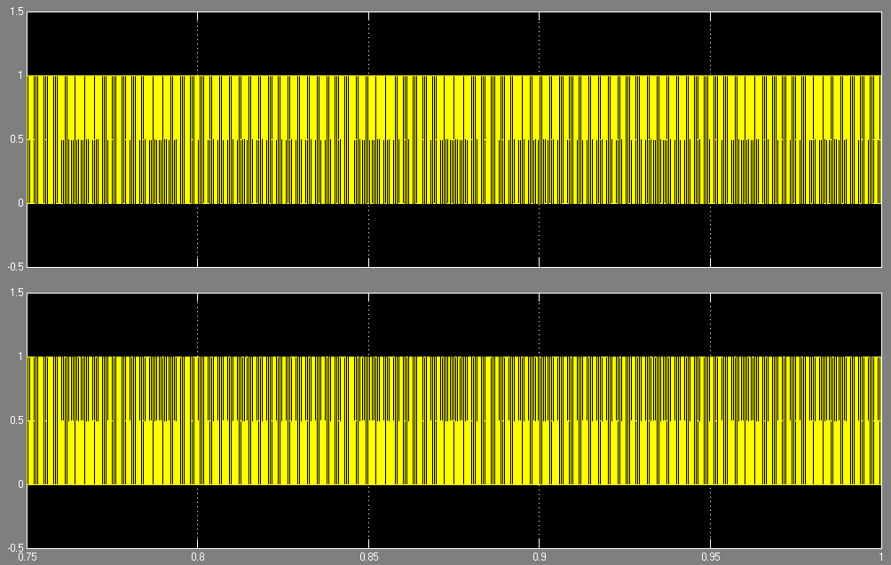
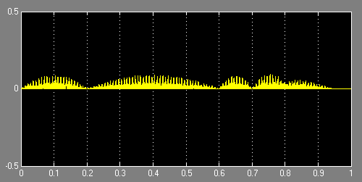
S_{a} and S_{b} pulsing signals
The current waveforms of MPFC

Slide 17
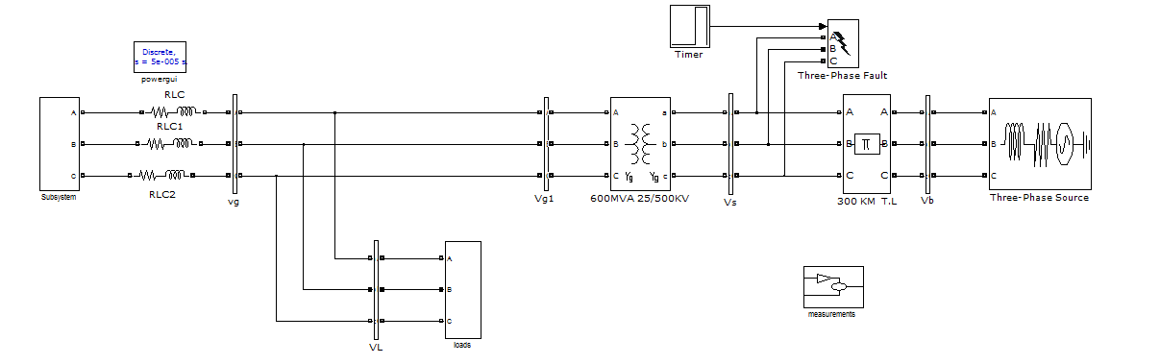
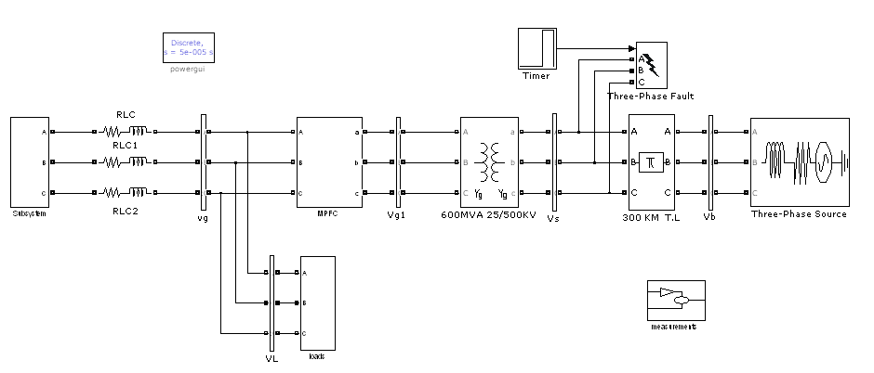
BLOCK DIAGRAM OF SHORT CIRCUIT FAULT CONDITION WITHOUT MPFC AND WITH MPFC:
Block Diagram of Short Circuit Fault Condition Case without MPFC
Block Diagram of Short Circuit Fault Condition Case with MPFC

Slide 18
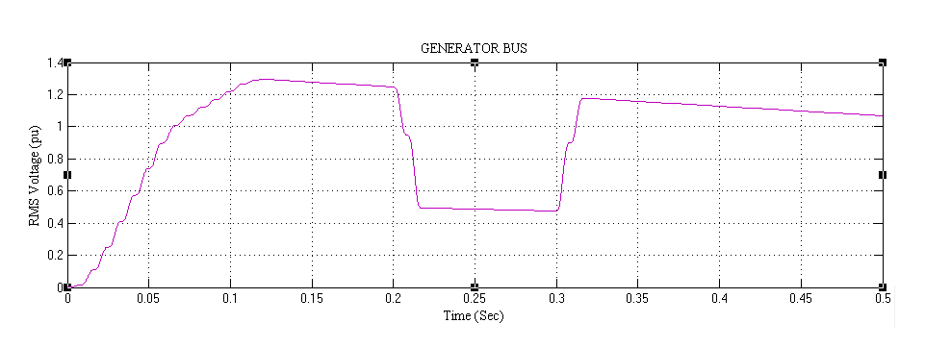
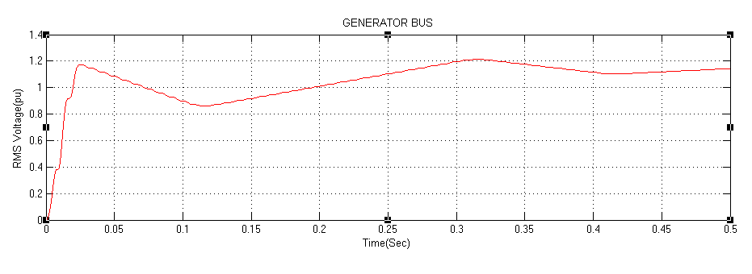
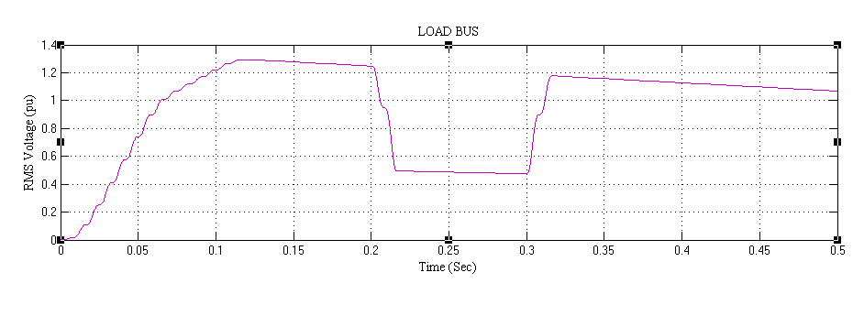
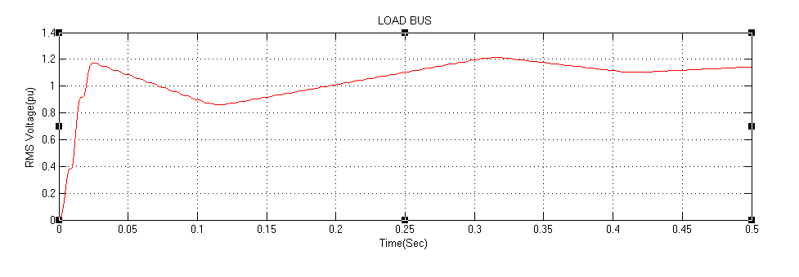
SIMULATION RESULTS OF SHORT CIRCUIT FAULT CONDITION CASE WITHOUT MPFC AND WITH MPFC
The RMS voltage at generator bus without MPFC
RMS voltage at generator bus with MPMC
The RMS voltage at Load bus without MPFC
The RMS voltage at Load bus with MPFC

Slide 19
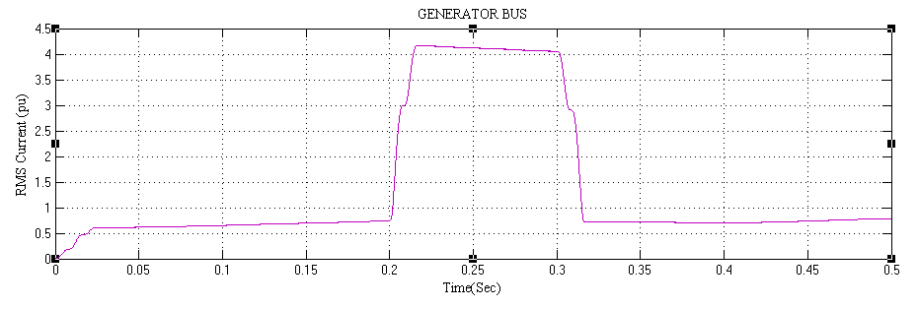
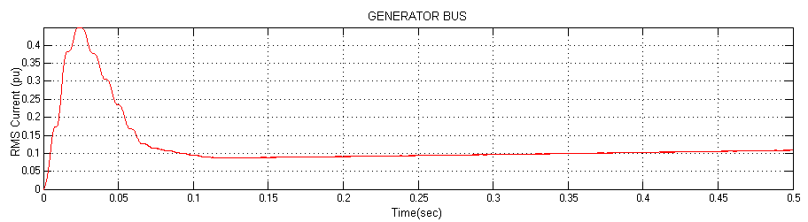
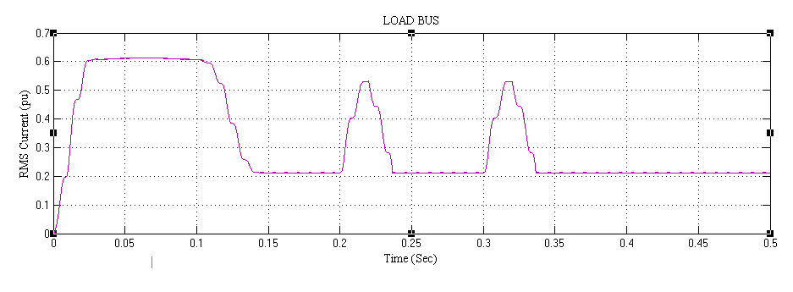
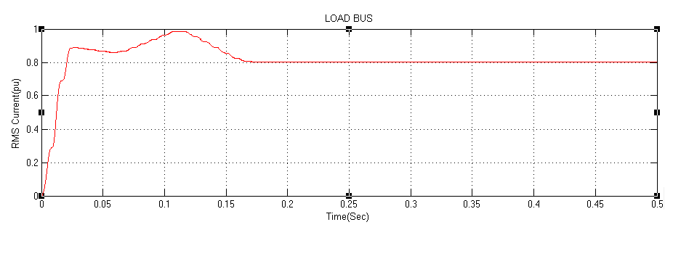
The RMS current at generator bus with MPFC
The RMS current at generator bus without MPFC
The RMS current at load bus without MPFC
The RMS current at load bus with MPFC

Slide 20
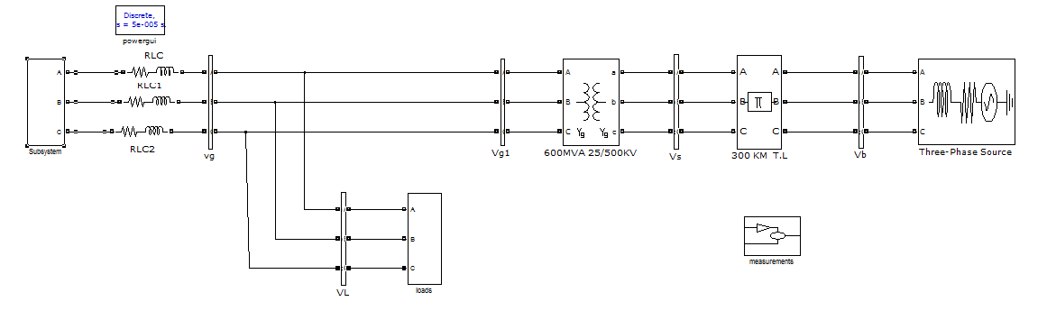
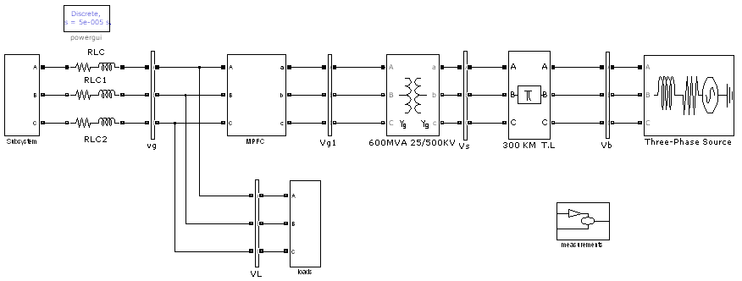
BLOCK DIAGRAM OF HYBRID LOCAL LOAD EXCURSION CASE WITHOUT MPFC AND WITH MPFC
Block Diagram of Hybrid Local Load Excursion Case without MPFC
Block Diagram of Hybrid Local Load Excursion Case with MPFC

Slide 21
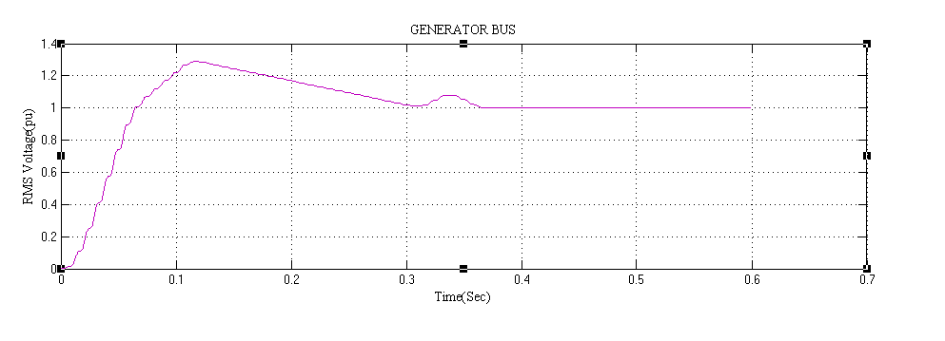
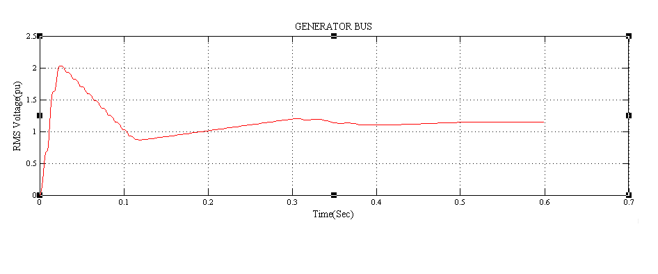
SIMULATION RESULTS OF HYBRID LOCAL LOAD EXCURSION CASE WITHOUT MPFC AND WITH MPFC
The RMS voltage waveform at the generator bus without MPFC
The RMS voltage waveform at the generator bus with MPFC

Slide 22
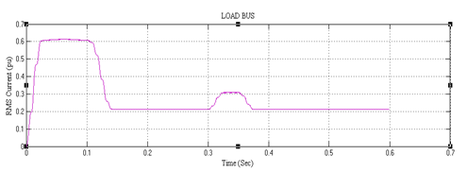
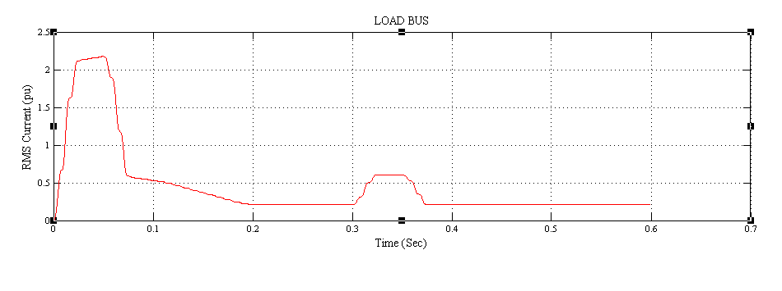
The RMS current waveform at the load bus without MPFC
The RMS current waveform at the load bus with MPFC

Slide 23
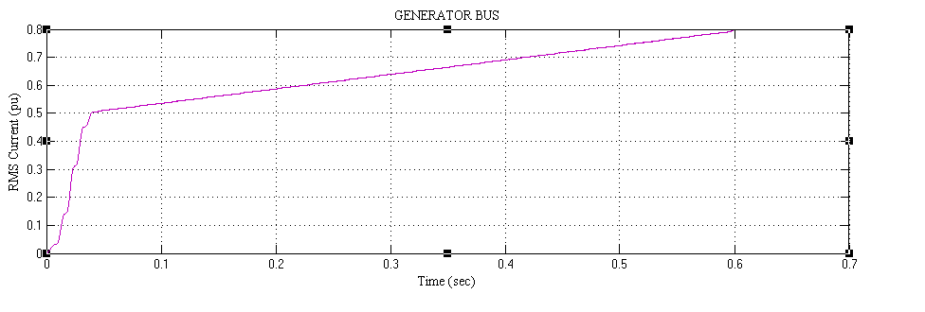
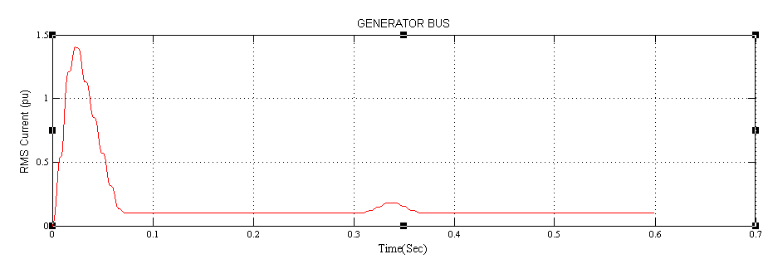
The RMS current waveform at the generator bus without MPFC
The RMS current waveform at the generator bus with MPFC

Slide 24
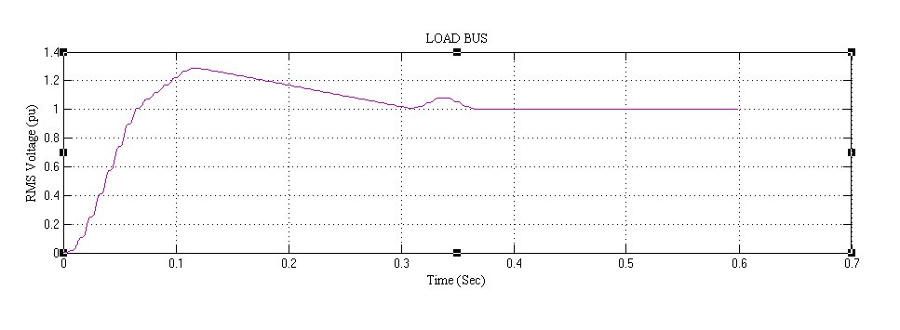
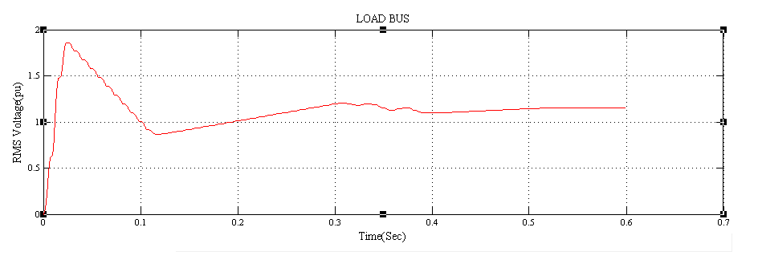
The RMS voltage waveform at the load bus without MPFC
The RMS voltage waveform at the load bus with MPFC

Slide 25
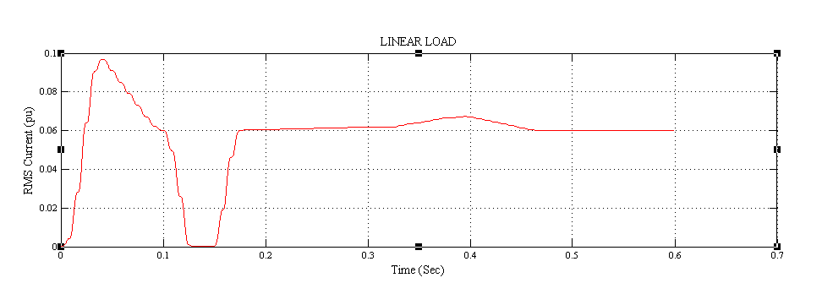
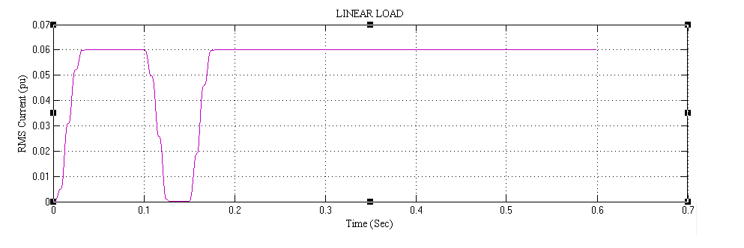
The linear load RMS current waveform without MPFC
The linear load RMS current waveform with MPFC

Slide 26
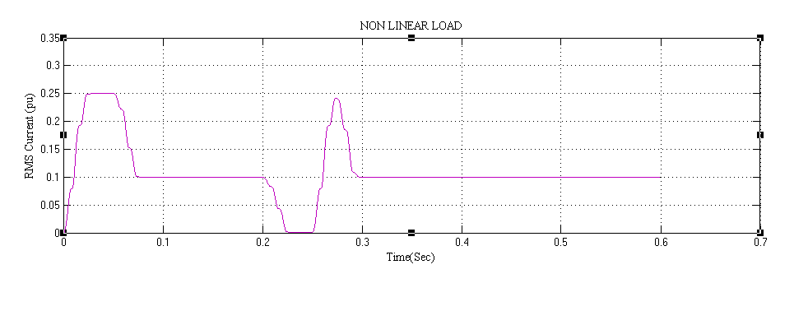
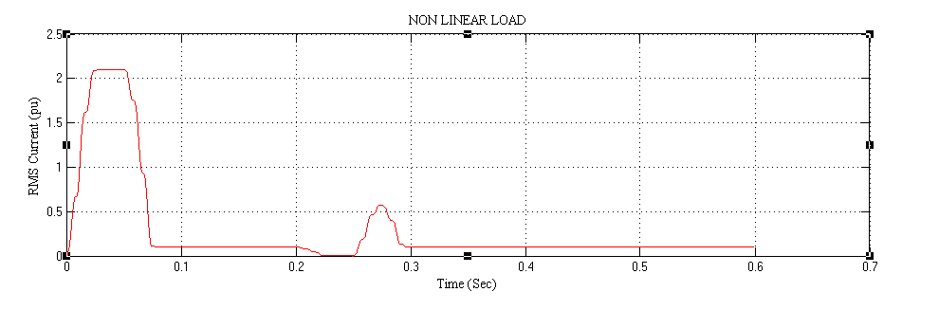
The nonlinear load RMS current waveform without MPFC
The nonlinear load RMS current waveform with MPFC

Slide 27

CONCLUSION:
The simulation model of the proposed MPFC scheme has been validated for effective power quality improvement, voltage stabilization, and power factor correction and transmission line loss reduction.

Slide 28



Slide 29


